Slide 1
TEAM 39
DIGITILIGATION OF LIVE CERTIFICATE FOR PENSIONERS
TEAM MEMBERS
SHIYAS TS
SAI GANESH POPURI
AFFEN MOHAMMED NM
AQUEEL AFTAB RAWTHER

Slide 2
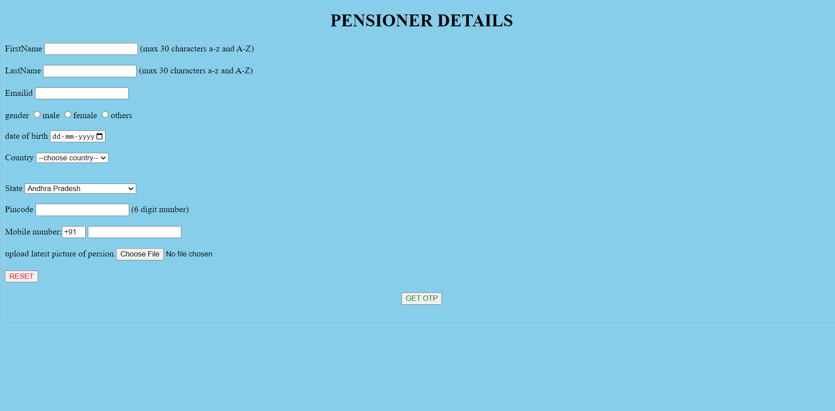
ENTER THE DETAILS OF THE PENSIONER

Slide 3

ENTER OTP SENT ON YOUR MOBILE NUMBER

Slide 4
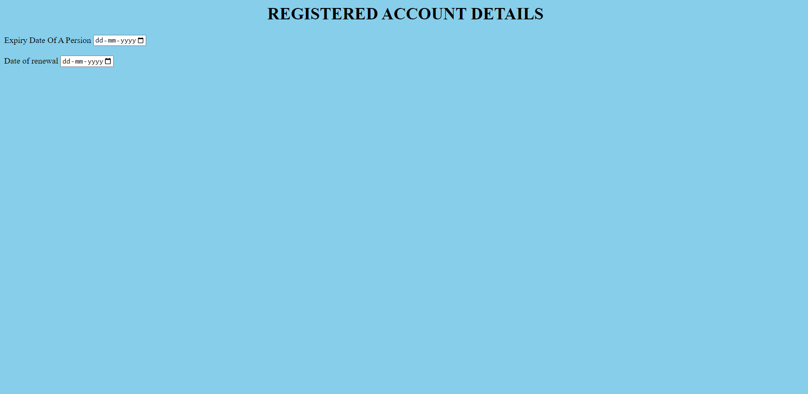
ENTER EXPIRY DATE AND RENEWAL DATE OF A PERSION

Slide 5
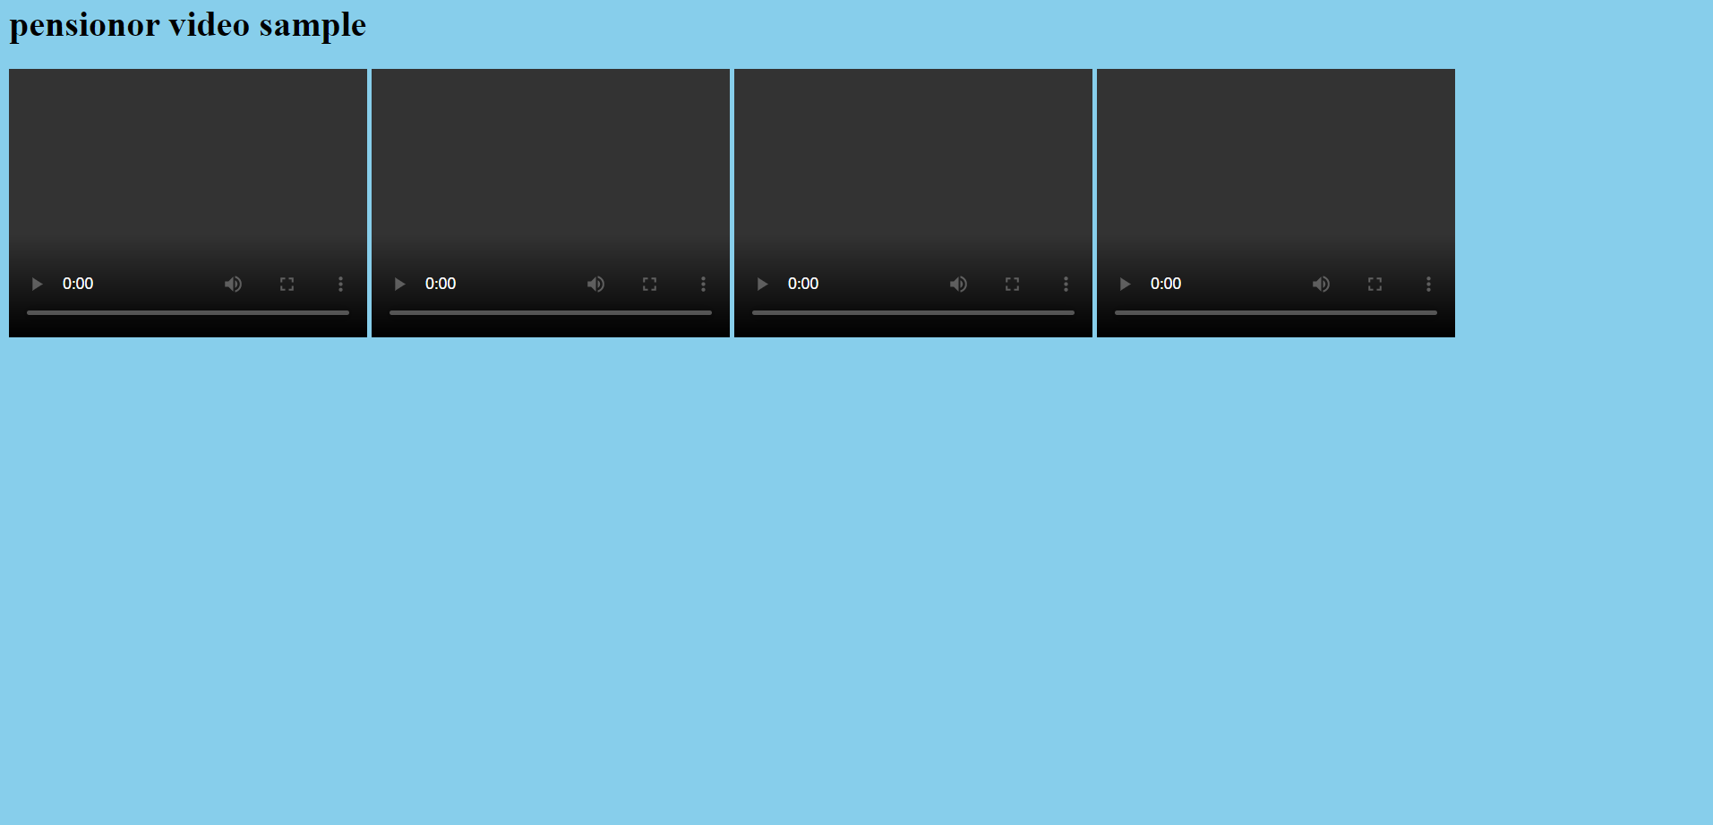
ADD PENSIONER LIVE VIDEO

